Slide 1

NumPy - a library for matrices

Slide 2
What does NumPy allow you to do?
Numpy is a Python library for manipulation of matrices:
Matrix manipulation: instantiation, edition, reshaping, ...
Matrix operations: addition, multiplication, inverse, determinant, ...
Linear algebra operations: equation solving, matrix decomposition,
eigenvalues, ...
Other basic math functions: trigonometry, random number generation, …
A lot of very powerful math functions for statistics, polynomials, logic,
financial, … optimized for Python.

Slide 3
NumPy Arrays
A vector (4 5 6) can be created by calling np.array:
You can also create a matrix by passing a multidimensional array to np.array:
>>> A = np.array([4, 5, 6])
>>> A = np.array([[4, 5], [5, 6]])

Slide 4
Basic operations
You can add/subtract two matrices with + and -:
You can also multiply a matrix by a scalar
>>> a = np.array([20, 30, 40, 50])
>>> b = np.array([0, 1, 2, 3])
>>> c = a - b
array([20, 29, 38, 47])
>>> A = np.array([[1, 2],[2, 3]])
>>> B = 10*A
array([[ 10, 20],
[ 20, 30]])

Slide 5

Basic operations
You can add/subtract two matrices with + and -:
You can also multiply a matrix by a scalar
>>> a = np.array([20, 30, 40, 50])
>>> b = np.array([0, 1, 2, 3])
>>> c = a - b
array([20, 29, 38, 47])
You can also divide by a scalar, compute the square or the square root of each element, etc.
>>> A = np.array([[1, 2],[2, 3]])
>>> B = 10*A
array([[ 10, 20],
[ 20, 30]])

Slide 6
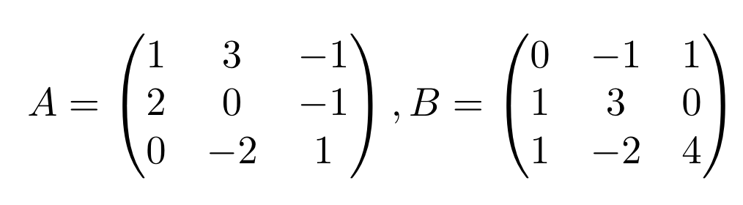
Your turn!
Compute C with:
C = 2 A - 0.5 B

Slide 7
Special matrix creation
A matrix full of 0s can be created by calling np.zeros :
The same goes with ones
You can also call an incrementing vector by calling np.arange:
>>> np.zeros((3,4))
array([[ 0., 0., 0., 0.],
[ 0., 0., 0., 0.],
[ 0., 0., 0., 0.]])
>>> A = np.ones((2,3))
array([[ 1., 1., 1.],
[ 1., 1., 1.]])
>>> np.arange( 10, 30, 5 )
array([10, 15, 20, 25])

Slide 8
Axis-wise operations
Each dimension is an axis, some operations can be performed axis-wise:
>>> A = np.array([[ 0, 1, 2, 3],
[ 4, 5, 6, 7],
[ 8, 9, 10, 11]])
>>> np.sum(A, axis=0)
array([12, 15, 18, 21])
>>> np.max(A, axis=1)
array([ 3, 7, 11])

Slide 9
Axis-wise operations
Each dimension is an axis, some operations can be performed axis-wise:
>>> A = np.array([[ 0, 1, 2, 3],
[ 4, 5, 6, 7],
[ 8, 9, 10, 11]])
>>> np.sum(A, axis=0)
array([12, 15, 18, 21])
>>> np.max(A, axis=1)
array([ 3, 7, 11])
You can also compute the np.min() and np.mean()

Slide 10
Your turn!
Instantiating ONLY one matrix M, compute a and b where
a is the sum of all odd numbers from 0 to 500
b is the sum of all even numbers from 0 to 500

Slide 11
Useful features
Number of dimensions:
Shape:
Number of items:
>>> A = np.array([[4, 5, 6], [5, 6, 7]])
>>> np.ndim(A)
2
>>> np.shape(A)
(2, 3)
>>> np.size(A)
6

Slide 12
Random (1/2)
A random number between 0 (inclusive) and 1 (exclusive) can be generated using np.random.rand():
Similarly, use this to generate a matrix of numbers by specifying the shape:
>>> np.random.rand()
0.22689366747057116
>>> np.random.rand(2, 3)
array([[ 0.512432, 0.725554, 0.904192],
[ 0.223564, 0.424663, 0.681788]])

Slide 13
Random (2/2)
A single integer, or matrix of integers, can also be generated by specifying the minimum value, maximum value, and shape:
>>> np.random.randint(0, 4)
3
>>> np.random.randint(0, 4, (2, 2))
array([[0, 2],
[1, 1]])

Slide 14
Your turn!
1) Instantiate a random matrix M of numbers between 0 and 5, with random numbers of rows l and columns L between 1 and 10.
2) Compute A, the vector of column averages, and a, the total average of the matrix.
3) Output l and L.

Slide 15
Matrix products
Element-wise product
Dot product:
>>> A = np.array( [[1,1],[0,1]] )
>>> B = np.array( [[2,0],[3,4]] )
>>> C = A*B
array([[2, 0],
[0, 4]])
>>> D = np.dot(A, B)
array([[5, 4],
[3, 4]])

Slide 16
Indexing
1 dimensional matrix
2 dimensional matrix
>>> A = np.array([1,1,0,1])
>>> B = A[1]
1
>>> C = A[2]
0
>>> D = np.array( [[1,2], [3,4]] )
>>> E = D[1,0]
3

Slide 17
Slicing (1/2)
This is used to select a contiguous subset of an array along any dimensions, the “:” operator performs this
>>> A = np.array([1,1,0,1])
>>> A[1:3]
array([1, 0])
>>> A[:2]
array([1, 1])

Slide 18

Slicing (1/2)
This is used to select a contiguous subset of an array along any dimensions, the “:” operator performs this
>>> A = np.array([1,1,0,1])
>>> A[1:3]
array([1, 0])
>>> A[:2]
array([1, 1])

Slide 19
Slicing (2/2)
Multidimensional slicing: what does this do?
>>> A = np.random.randint(0, 5, (3, 4))
>>> print(A)
[[2 3 1 4]
[3 1 1 1]
[0 3 3 4]]
>>> A[:2,1:3]
array([[3, 1],
[1, 1]])

Slide 20

Your turn!
With:
Compute C, the elementwise product of A and B. Output C_last, the bottom right element of Cn
Change C_last to 0.
Compute D, the dot product of B and C. Output D’, the right-top 2x2 matrix of D.

